Slide 1

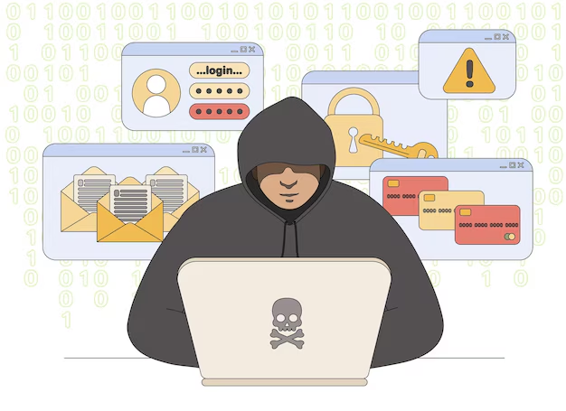
Session 5
Cyber Attacks - Introduction to Social Engineering

Slide 2
Learning Outcomes :
By the end of this session, we will be able to:
Define what cyber attacks are and understand their purpose.
List and explain different types of cyber attacks.
Understand the concept of social engineering and its impact.
Identify various forms of social engineering attacks.
Recognize the tactics used by attackers to exploit human behavior.

Slide 3
Understand :
What Are Cyber Attacks?
Different Types of Cyber Attacks
Introduction to Social Engineering
Forms of Social Engineering Attacks
Real-life Examples of Social Engineering
Defensive Strategies Against Social Engineering

Slide 4
What Are Cyber Attacks ?
Cyber attacks are deliberate attempts by malicious individuals or groups to breach the security of a computer system, network, or device.
These attacks aim to steal sensitive data, disrupt operations, or gain unauthorized access to systems.
Cyber attacks are often categorized into:
Technical Attacks: Use tools like malware, ransomware, or viruses to exploit software vulnerabilities.
Social Engineering Attacks: Manipulate human psychology to trick victims into providing sensitive information or access.

Slide 5
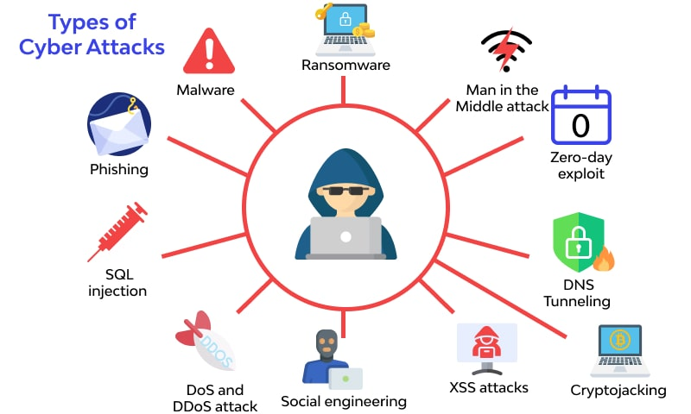

Slide 6

Why Are Cyber Attacks Dangerous ?
Financial Loss: Cyber attacks can result in significant monetary losses for individuals and organizations.
Data Breach: Sensitive information, such as passwords or personal details, can be stolen.
Reputation Damage: Companies may lose customer trust after a successful attack.
Operational Disruption: Cyber attacks can paralyze systems and halt services.

Slide 7

What Is Social Engineering?
Social engineering is a method used by attackers to manipulate individuals into revealing confidential information or performing actions that compromise security.
Unlike technical attacks, social engineering relies on exploiting human psychology rather than software vulnerabilities.
Key Concept: Humans are often the weakest link in cybersecurity, making social engineering a powerful tool for attackers.

Slide 8

Why Is Social Engineering Effective ?
Trust Exploitation: Attackers impersonate trusted individuals or organizations.
Pressure Tactics: Victims are made to feel a sense of urgency or fear.
Lack of Awareness: Many people are unaware of social engineering tactics.
Over-Reliance on Technology: Users often assume systems are secure without considering human factors.

Slide 9
Forms of Social Engineering Attacks
Phishing
Attackers send fake emails or messages pretending to be legitimate entities.
Victims are tricked into sharing sensitive information like passwords or credit card details. Example: An email from a fake bank asking you to reset your password.
Pretexting
Attackers create a false scenario to gain information or access.
Often involves impersonating authority figures or trusted contacts. Example: A fake IT technician requesting login credentials.

Slide 10
Forms of Social Engineering Attacks…
Baiting
Attackers use enticing offers (e.g., free USB drives, movie downloads) to trick users into downloading malware or providing sensitive information. Example: A USB labeled "Confidential" left in a public space to lure someone into plugging it into their computer.
Tailgating (Piggybacking)
Gaining unauthorized access to secure areas by following someone with legitimate access. Example: An attacker following an employee through a secure door without showing credentials.

Slide 11
Real-Life Examples of Social Engineering
Example 1: The 2016 “Google Docs” Phishing Scam
Millions of users received fake emails pretending to share Google Docs, leading to compromised accounts.
Example 2: Pretexting in Telecom
Attackers posed as customer service agents to obtain account details.

Slide 12

Defensive Strategies Against Social Engineering
Awareness and Training
Regular training sessions to help individuals recognize social engineering attempts.
Verification Practices
Always verify requests for sensitive information through trusted channels.
Use Multi-Factor Authentication (MFA)
Adds a layer of security, making it harder for attackers to succeed.
Limit Information Sharing
Avoid sharing personal or organizational information publicly.
Report Suspicious Activity
Encourage reporting any suspected phishing or suspicious behavior.

Slide 13


PYTHON PRACTICAL ACTIVITY ( Code Link )
Practical Activity # 1 (Phishing Email Detector (Simple Keyword-Based Filter))
Practical Activity # 2 (Fake IT Support Pretexting Simulator (User Awareness Test))
Practical Activity # 3 (USB Baiting Simulation (Safe Demonstration of Auto-Execution Danger))
Practical Activity # 4 (Tailgating Awareness Visual Prompt)
Practical Activity # 5 (Suspicious Link Verifier using Regex)

Slide 14
Practical Activity # 1 (Phishing Email Detector (Simple Keyword-Based Filter))
🔐 Demonstrates simple keyword-based scanning can help identify potential phishing emails and protection.
def detect_phishing_email(subject, body):
phishing_keywords = ['urgent', 'verify your account', 'password', 'login', 'click here', 'update', 'suspended']
content = f"{subject} {body}".lower()
for keyword in phishing_keywords:
if keyword in content:
return True
return False
# Usage
subject = "Your account is suspended"
body = "Click here to verify your login credentials immediately."
if detect_phishing_email(subject, body):
print("⚠️ Potential phishing email detected.")
else:
print("✅ Email appears to be safe.")

Slide 15
Practical Activity # 2 (Fake IT Support Pretexting Simulator (User Awareness Test))
🔐 Demonstrates how simulated social engineering calls can raise awareness about pretexting and credential theft risks.
def simulate_pretexting():
print("Simulated Call: Hello, this is John from IT support. We detected unusual activity on your account.")
print("To secure it, may I have your login username and password?")
username = input("Enter your username: ")
password = input("Enter your password: ")
print("\n🚨 WARNING: You should NEVER share credentials over unsolicited calls.")
print("✅ This was a simulation to test awareness against pretexting attacks.")
simulate_pretexting()

Slide 16
Practical Activity # 3 (USB Baiting Simulation (Safe Demonstration of Auto-Execution Danger))
🔐 Demonstrates how seemingly innocent files or devices can trick users into executing malicious content.
import os
def baiting_simulation():
filename = "Free_Movie_Download.txt"
with open(filename, "w") as f:
f.write("🎬 Congratulations! Click this fake link to download your movie: http://malicious-link")
print(f"{filename} created. If this were a real USB bait, malware could have been executed.")
print("🛡️ Do not trust free items or unknown USB drives.")
baiting_simulation()

Slide 17
Practical Activity # 4 (Tailgating Awareness Visual Prompt)
🔐 Demonstrates how social compliance can be exploited and emphasizes the importance of physical access control awareness.
def tailgating_awareness():
print("Scenario: You are entering a secure building, and someone asks to follow behind you without a badge.")
response = input("Do you let them in? (yes/no): ").strip().lower()
if response == 'yes':
print("❌ Security Risk: This could be a tailgating attack. Always verify access.")
else:
print("✅ Correct: Never allow unauthorized individuals to piggyback.")
tailgating_awareness()

Slide 18
Practical Activity # 5 (Suspicious Link Verifier using Regex)
🔐 Demonstrates how pattern recognition can help users detect and avoid suspicious or malicious URLs.
import re
def is_suspicious_link(url):
suspicious_patterns = [r"bit\.ly", r"tinyurl\.com", r"login.*\.com", r"verify.*\.net"]
for pattern in suspicious_patterns:
if re.search(pattern, url):
return True
return False
# Usage
test_url = "http://bit.ly/verify-your-account"
if is_suspicious_link(test_url):
print("⚠️ Suspicious link detected! Avoid clicking.")
else:
print("✅ Link seems normal.")

Slide 19


Exercise
1. What is the primary goal of a social engineering attack? A) To crash the network through malware B) To steal hardware from secure facilities C) To manipulate people into giving away sensitive information D) To physically damage servers Answer: C
2. Which of the following is an example of a phishing attack? A) A fake IT technician calling to ask for credentials B) An email prompting you to click a link and reset your password C) A person following you through a secure door D) A USB stick labeled “Confidential” left in a public space Answer: B

Slide 20
Exercise
3. Why is social engineering often successful? A) Most users have antivirus software installed B) Users fully understand cyber laws C) It exploits human psychology and trust D) It uses strong encryption algorithms Answer: C
4. What is baiting in the context of social engineering? A) Using psychological tactics to scare users B) Offering something attractive to trick users into downloading malware C) Following someone into a secure building D) Impersonating a CEO through email Answer: B
5. Which of the following is a good defense against social engineering attacks? A) Ignoring email from unknown senders B) Using only antivirus software C) Avoiding all online communication D) Awareness training and multi-factor authentication Answer: D

Slide 21
Conclusion
Cyber attacks, especially social engineering, pose significant threats to individuals and organizations.
Understanding these tactics and staying vigilant can significantly reduce the risk.
Always think before you click or share information.

